Slide 1

Design and Development of Harmonic Transponder for Search and Rescue in S and C band
Gadamchetty Rahul
124004420
ECE /Sec A
G.Chinmaya
124004417
ECE /Sec E
Y.Sai Sri Harsha
124004440
ECE /Sec E
Dr. A Rajesh
Professor
Department of SEEE/ECE
Sastra University

Slide 2
Presentation Outline
Background and Problem Statement
Objective of the work
Literature Survey
Proposed Methodology
Reference

Slide 3
Background and Problem Statement
It becomes extremely difficult when there is situation of search and rescue Operation in ships as ocean are very big and it is not possible to use radars and travel long distances along the sea so to avoid this problem we use SART.
SART or Search and Rescue Transponder is extremely vital equipment on the ship as it performs the job of a single man.
It is a vital machine during distress for it helps in locating the position of the vessel in case it goes off-track.
SARTs are made of waterproof components which protects them against damage by water.

Slide 4
SARTs are essentially battery-operated, hence can be operative for a long time. SARTs are of use in ships, lifeboats .They are the most supportive machines in case of an unprecedented emergency.
SARTs are designed to remain afloat on the water for a long time in case the vessel finds itself submerged in water.
The bright color of SARTs enables their quick detection, whereas the combination of transmitter and receiver enables it to transmit as well as receive radio signals.

Slide 5
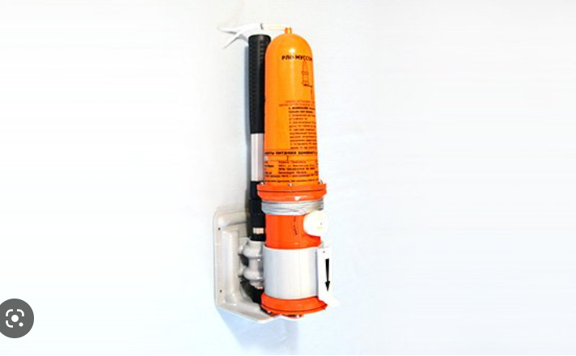
Objective of the work
Even if SARTs are very much useful battery operated SART becomes as it has to be charged and it can’t last for long time and tradition very difficult to use because they are battery operated which makes its very discomfortable al size of SARTs are very big in size.

Slide 6
So it will reduces the size of SART and as it is battery free(operated without battery it can be used anytime).
So we are trying to design microstrip SART which is battery free and it is being operated at s band frequency(2 to 4 GHz).
Practically they are using SARTs which are operating in x-band we are making it to s band frequencies.

Slide 7
Literature survey
Title | Author
Design of Rectangular Microstrip Patch Antenna for 2.4 GHz applied a WBAN | Hector Kaschel, and Cristian Ahumada, | Results Achieved:A new design microstrip antenna for a wireless body area network has been investigated. The microstrip antenna designed for the 2.4 GHz
Optimization of Rectangular Patch Antenna Based on FR4, Teflon and Ceramic Substrates | M. Karthigai Pandian and T. Chinnadurai | Results Achieved: Design of a patch antenna at a frequency band of 9.5 GHz has been simulated

Slide 8
Literature survey
Title | Author
Microstrip Patch Antennas With Multiple Parasitic Patches and Shorting Vias for Bandwidth Enhancement | KAI DA XU 1,2,3, (Member, IEEE), HAN XU1, YANHUI LIU 1, (Member, IEEE), JIANXING LI4, AND QING HUO LIU5, (Fellow, IEEE) | Results Achieved: microstrip patch antenna with multiple parasitic patches for three resonances generation ,two shorting vias are added , input impedance can be lowered at some frequency ranges it’s designed.
Design of Microwave Bandpass Filters Using Resonators With Nonuniform Q | Andrew C. Guyette, Ian C. Hunter, Senior Member, IEEE, and Roger D. Pollard, Fellow, IEEE | Results Achieved: Design of bandpass filters with nonuniform resonators have been obtained using techniques

Slide 9
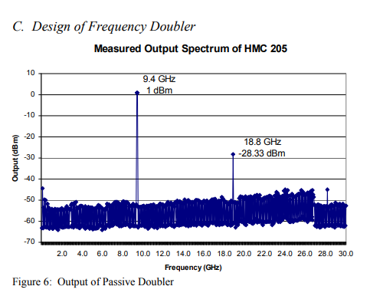
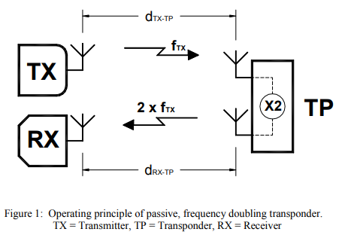
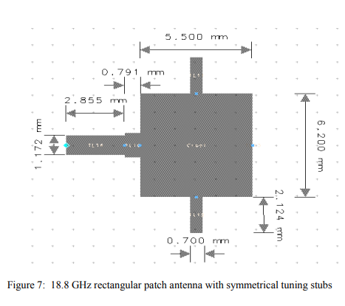
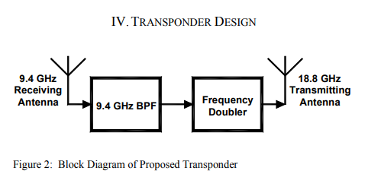
Proposed Methodology

Slide 10
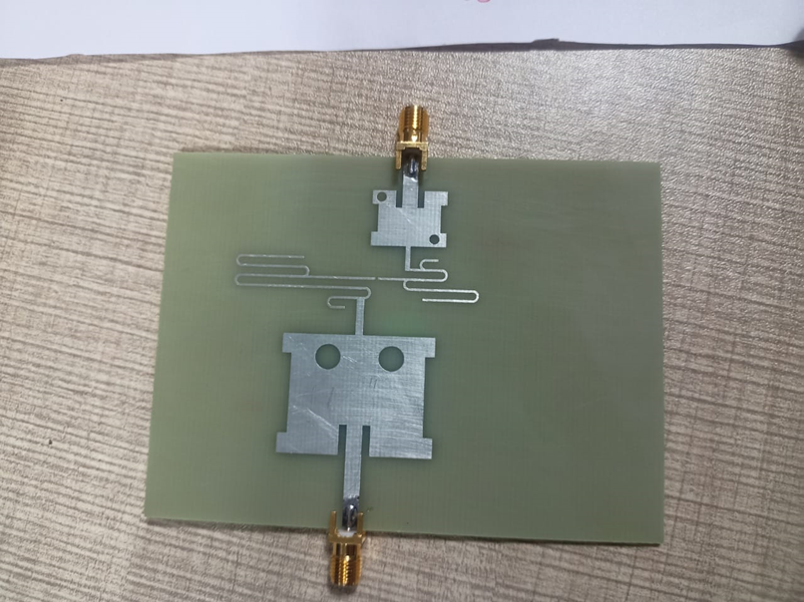
Proposed Methodology
We have designed shiv Transponder with is capable of detecting target around 500 m and is being operated in the frequency range of s-c bands and where it is have receiving frequency of 2.899 Ghz and transmitting frequency of 5.653 Ghz and it have a multiplication factor 1.9499.

Slide 11
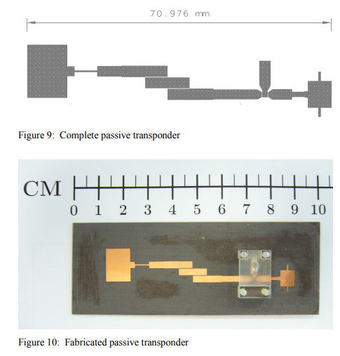
Existing Designs

Slide 12
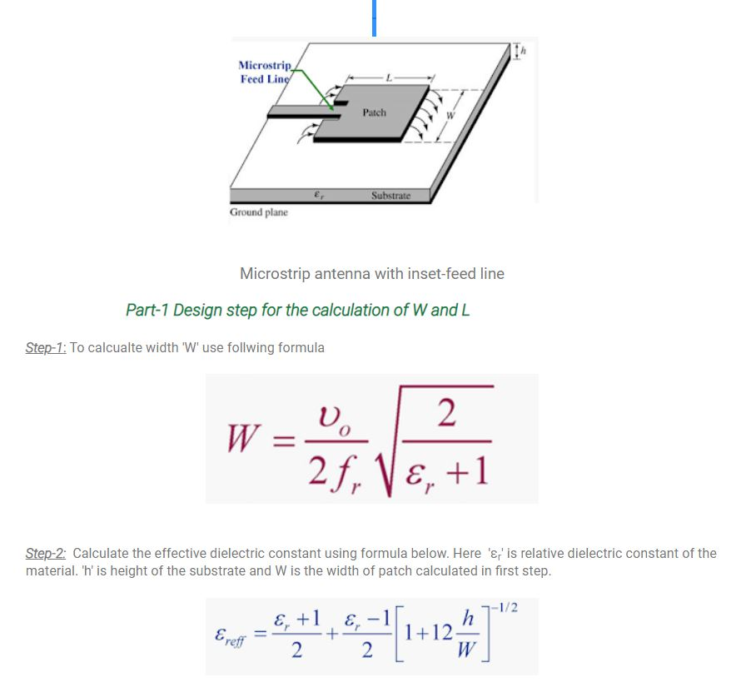

Slide 13
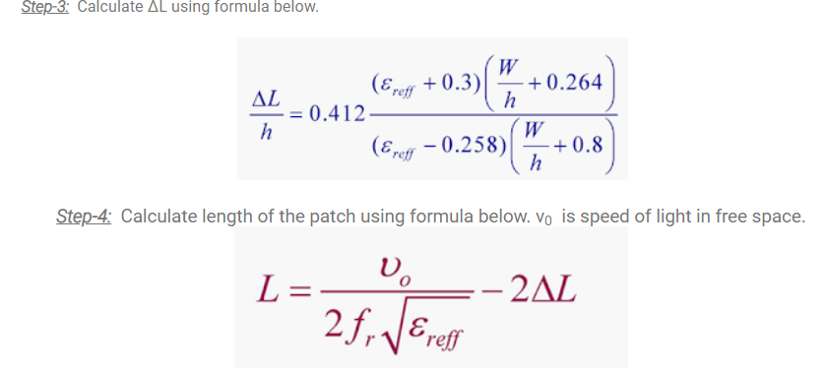

Slide 14
There are several ways to improve the sharpness of a rectangular patch antenna. Here are some tips:
Increase the substrate dielectric constant: By increasing the dielectric constant of the substrate, the wavelength of the electromagnetic wave is reduced, and the resonant frequency of the antenna is increased. This will result in a sharper frequency response.
Decrease the substrate thickness: By decreasing the thickness of the substrate, the surface wave losses are reduced, and the bandwidth of the antenna is increased, resulting in sharper frequency response.

Slide 15
Increase the length of the antenna patch : By increasing the length of the antenna patch, the resonant frequency of the antenna is decreased, resulting in a sharper frequency response.
Use a parasitic patch: By adding a parasitic patch close to the driven patch, the bandwidth of the antenna is reduced, and the sharpness of the frequency response is increased.
Tapering the edges of the antenna patch: By tapering the edges of the patch antenna, the current distribution on the patch is more uniform, which results in a sharper frequency response.

Slide 16
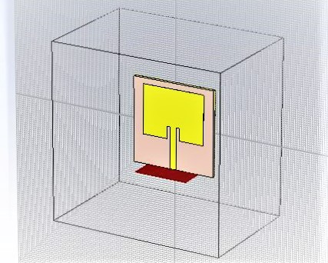

Receiver
Existing Design
Created Design

Slide 17
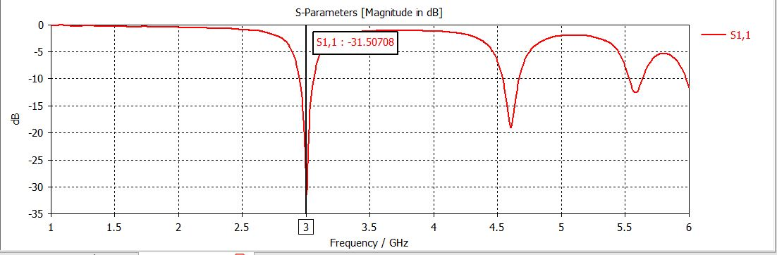
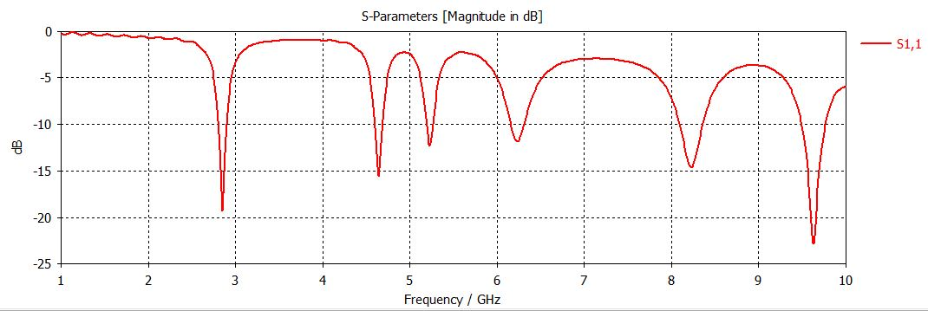
Receiver Result
Existed design o/p
Created design o/p

Slide 18
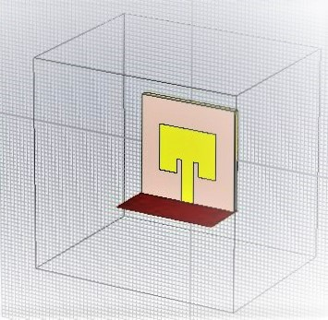
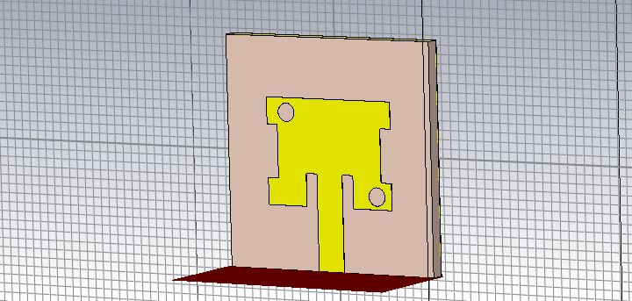
Transmitter
Existing Design
Created Design

Slide 19
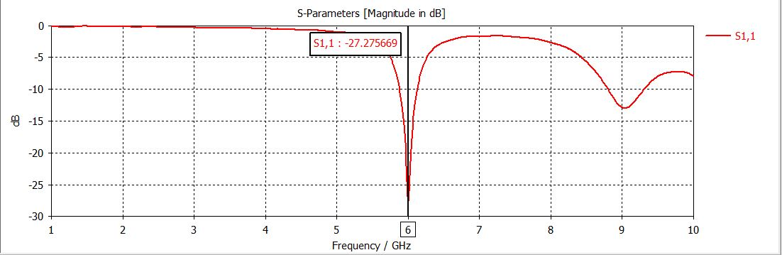
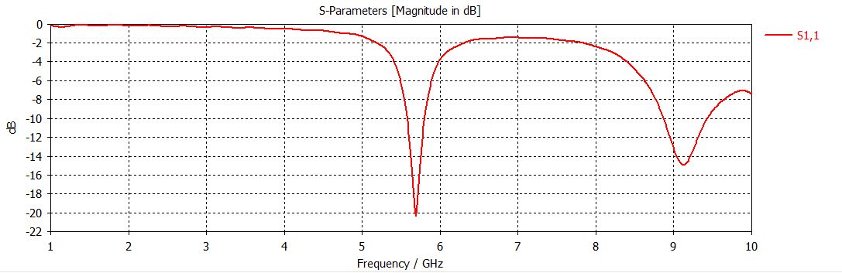
Transmitter Result
Existed design o/p
Created design o/p

Slide 20
Measurements & Results
Properties | Receiver | Transmitter
Substrate Type | FR4 | FR4
Operating Frequency | 2.908GHz | 5.653GHz
Length of the Patch | 23.43mm | 11.555mm
Width of the Patch | 30.42mm | 15.21mm
Thickness of Substrate | 1.6 | 1.6
Permittivity of Substrate | 4.3 | 4.3
Reflection Coefficient(S11) | -19 db | -21db

Slide 21
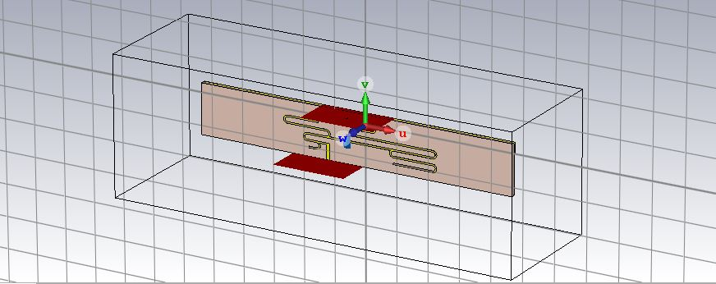
Frequency Doubler

Slide 22
Operation of Frequency multiplier
As frequency Increases wave length decreases and operation of frequency multiplier depends on ratio of lengths of lamba/2 stubs on both sides of the diodes the Em waves from one stub will Induce the another frequency in another stub with lower wavelength or higher frequency.Diode plays a important role in Frequency conversation here. Via holes or grounding are Introduced in lamda/4 stubs which will reduce the harmonics in higher frequencies

Slide 23
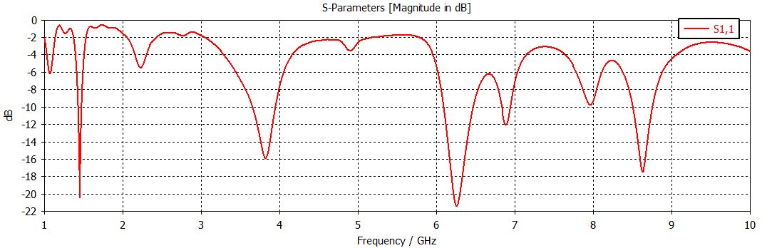
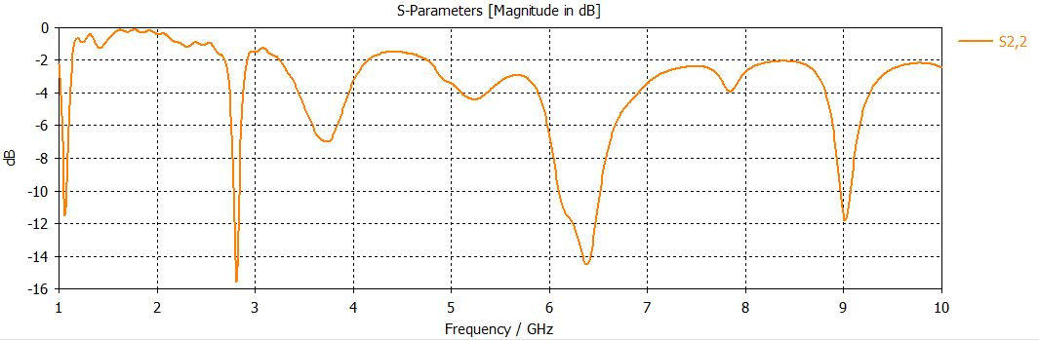
S-parameters
S11
S22

Slide 24
Defected Ground Structure
Microwave component with Defected Ground Structure (DGS) has been gained popularity among all the techniques reported for enhancing the parameters due to its simple structural design.
Etched slots or defects on the ground plane of microstrip circuits are referred to as Defected Ground Structure.
Single or multiple defects on the ground plane may be considered as DGS. Initially DGS was reported for filters underneath the microstrip line.
DGS has been used underneath the microstrip line to achieve band-stop characteristics and to suppress higher mode harmonics and mutual coupling.
After successful implementation of DGS in the field of filters, nowadays DGS is in demand extensively for various applications.

Slide 25
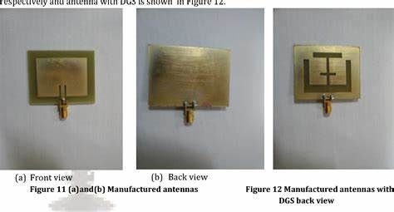
Defected Ground Structure
DGS has been used in the field of microstrip antennas for enhancing the bandwidth and gain of microstrip antenna and to suppress the higher mode harmonics, mutual coupling between adjacent element, and cross-polarization for improving the radiation characteristics of the microstrip antenna.

Slide 26
Defected Ground Structure
The role of DGS in the field of microwave and microstrip antennas is presented with various applications of DGS that is miniaturization, multiband performance, bandwidth enhancement, gain enhancement, mutual coupling suppression between two elements, higher mode harmonics suppression, cross-polarization suppression, notched band creation and circular polarization achievement.

Slide 27
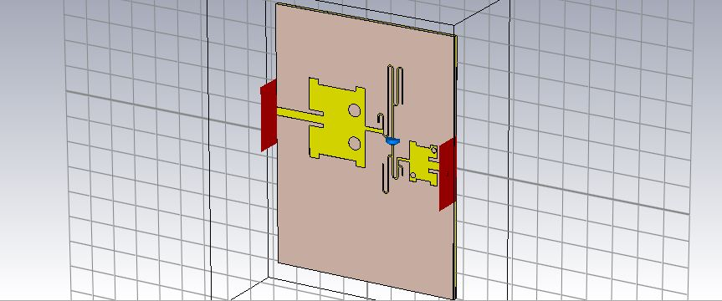
Integrated SART or Shiv Transponder (Front view)

Slide 28
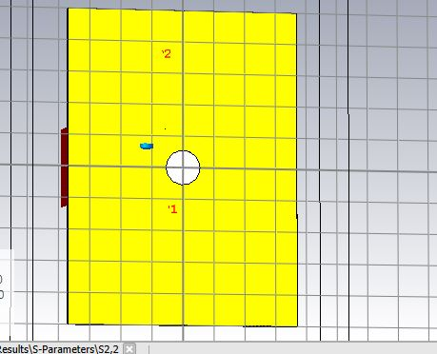
Shiv Transponder(Back view)

Slide 29
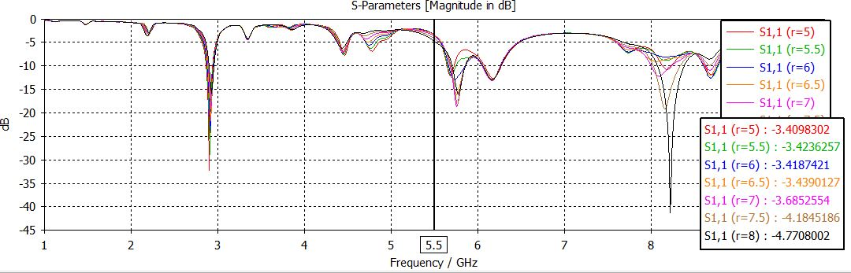
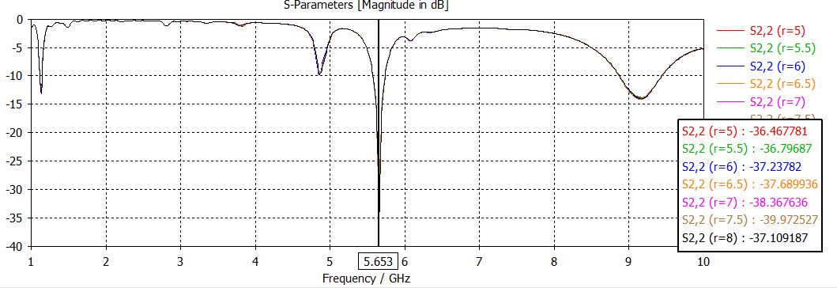
S- parameters(Parametric analysis)
S11
S22
We have did parametric analysis for radius of defected ground structure and we got best results for r=5

Slide 30
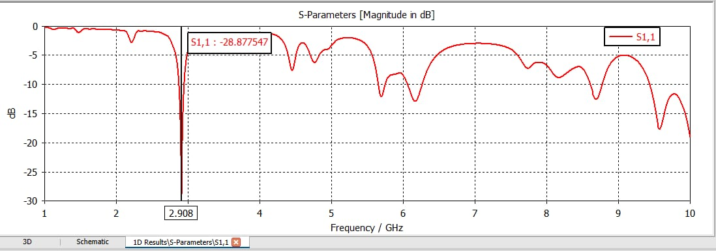
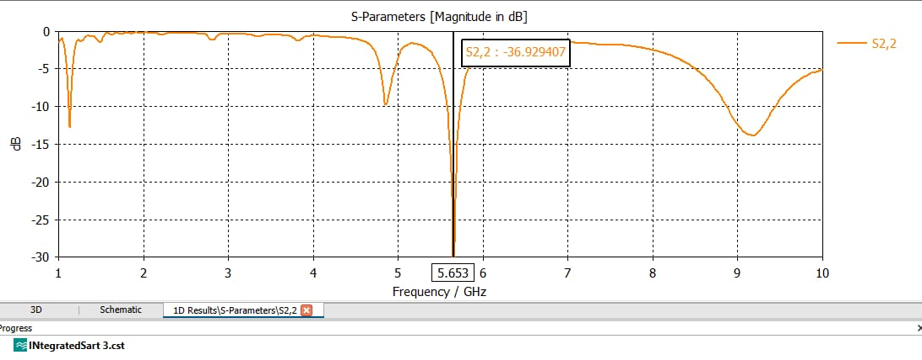
S- parameters(Best Results)
S11
S22

Slide 31
Measurements & Results
Properties | Receiver | Transmitter
Substrate Type | FR4 | FR4
Operating Frequency | 2.899 GHz | 5.653 GHz
s11 | -28 db | -36.92 db
VSwr | 1.169 | 1.02
Gain | 2db | 6.4db

Slide 32
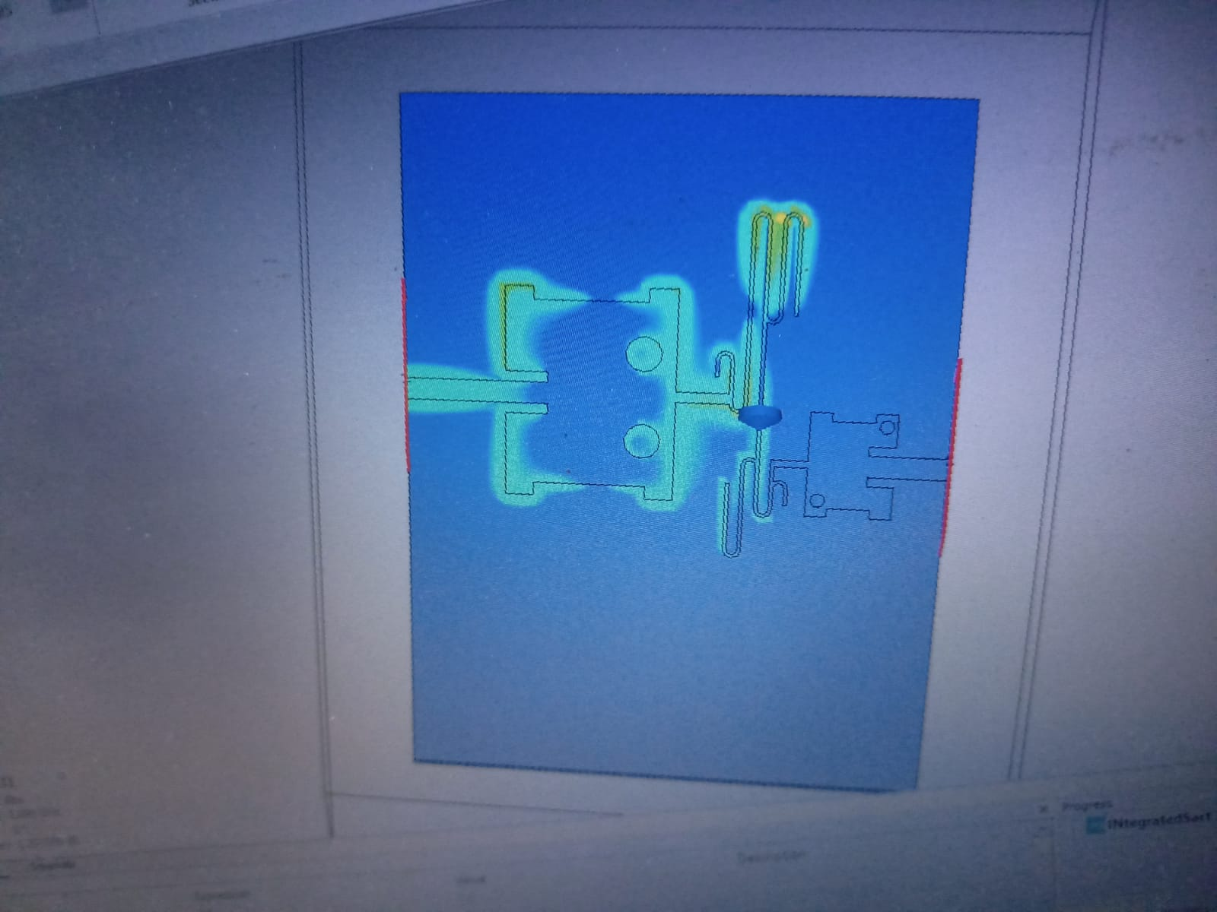
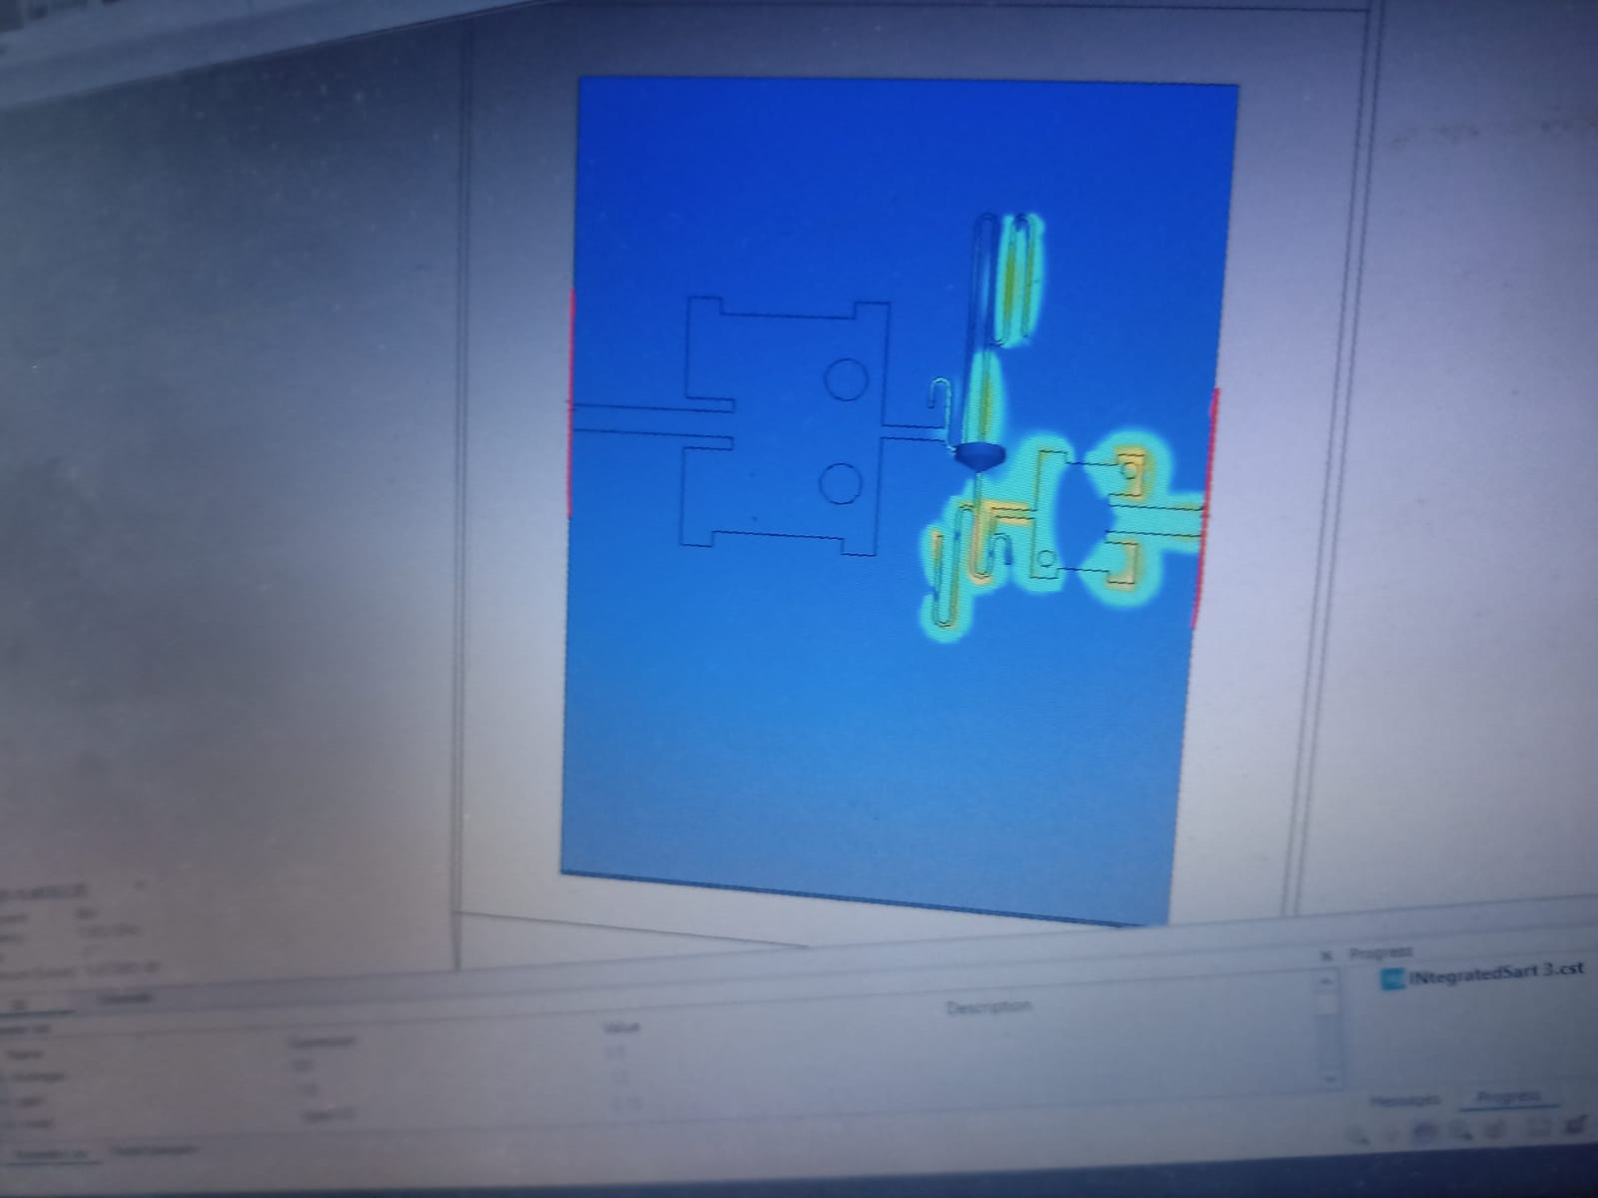
E fields
For 2.899 Ghz at port 1
For 5.653 at port 2

Slide 33
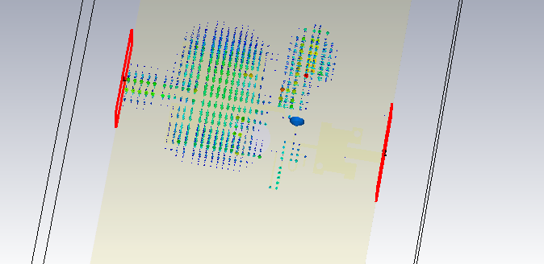
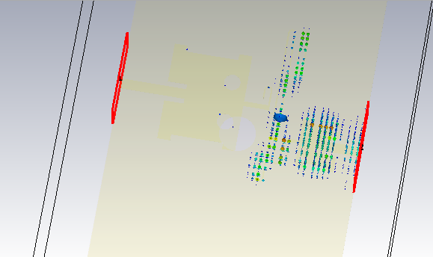
H fields
For 2.899 Ghz at port 1
For 5.653 at port 2

Slide 34
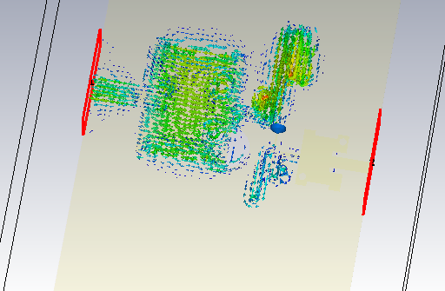
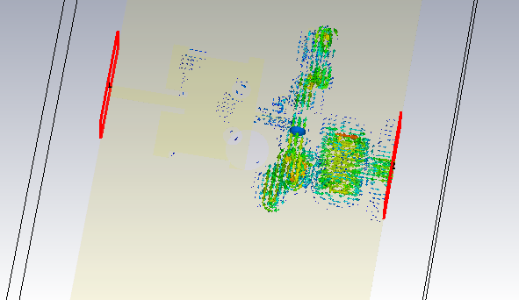
Surface Currents
For 2.899 Ghz at port 1
For 5.653 at port 2

Slide 35
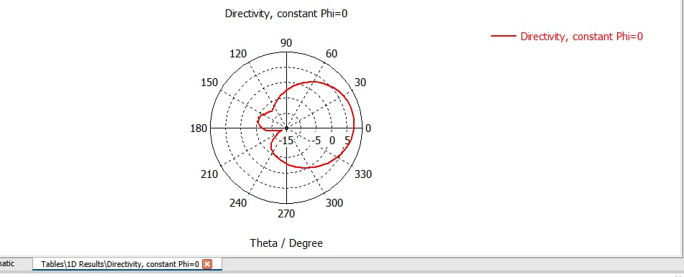

Directivity
Phi=0
Thetha=180

Slide 36

Gain

Slide 37

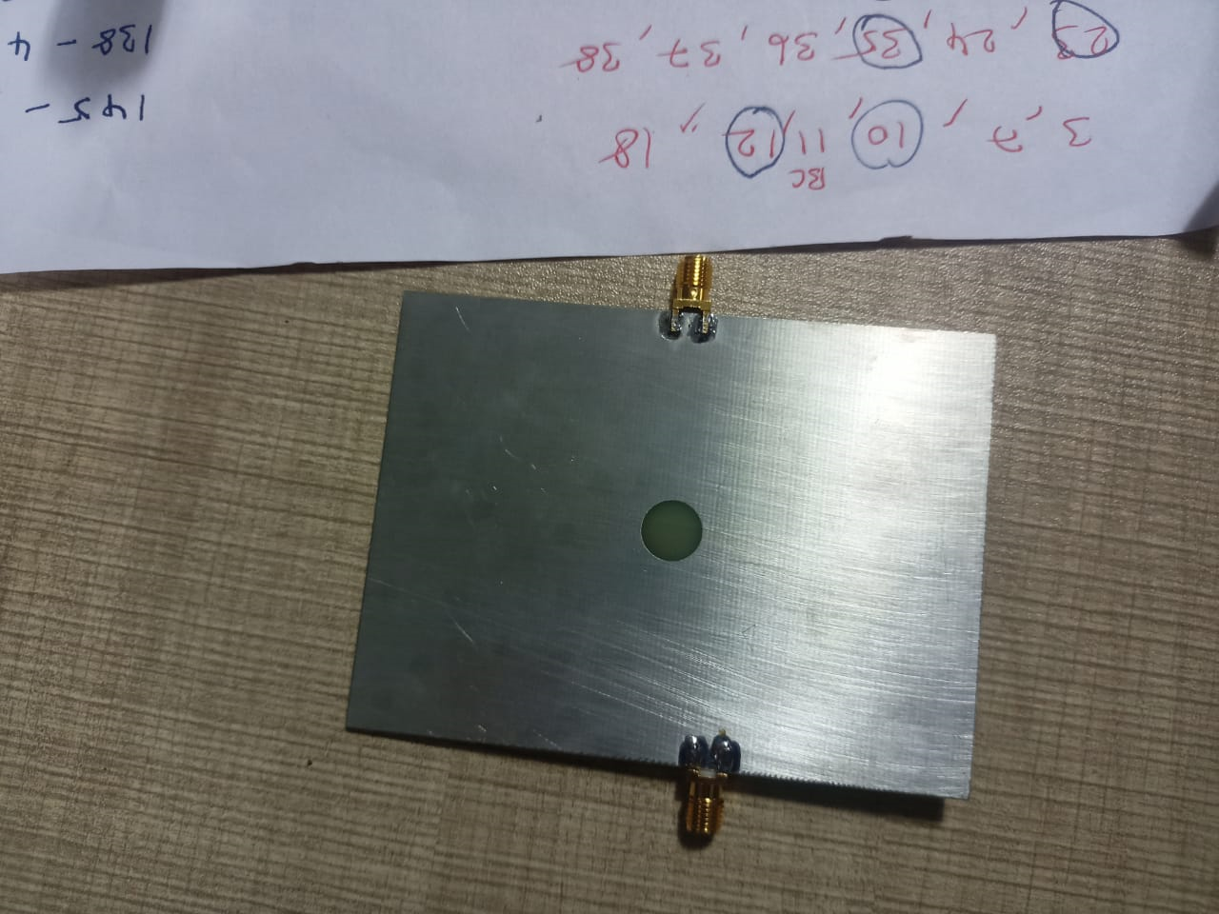
Shiv Transponder Hard ware Testing
Front view
Back view

Slide 38
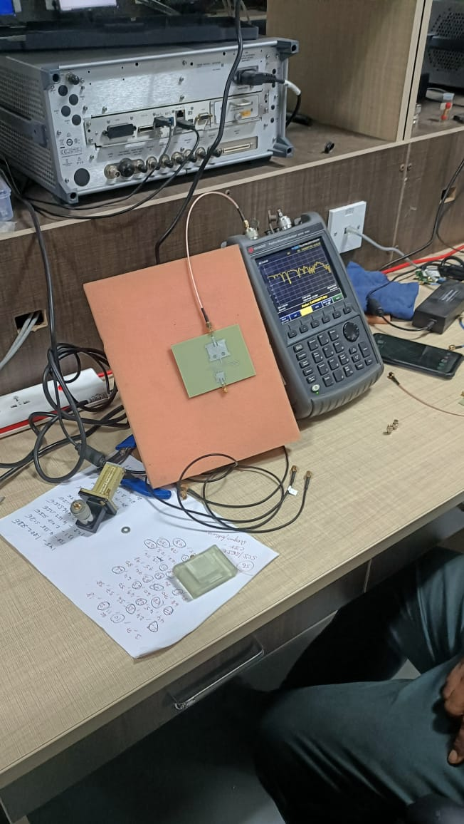
S Parameters testing using VNA for Receving antenna
We had observed -15 db at 3.0636GHz

Slide 39
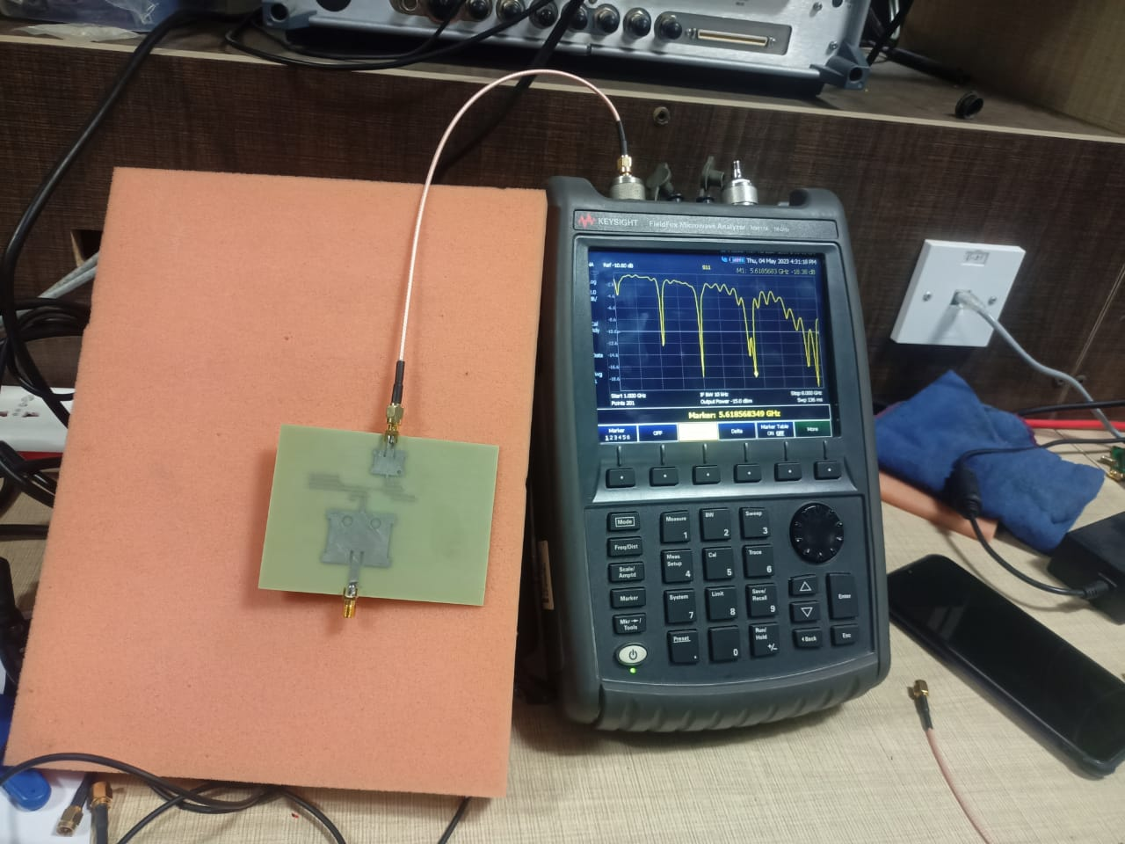
S Parameters testing for using VNA for Transmitting antenna
We had observed s11=-19.0db at 5.615 Ghz

Slide 40
Motivation to go from active to passive Transponder
Parameters | Active Transponder | Passive Transponder
Definition | An active transponder requires an external power source to amplify the signal it receives and retransmit it back to earth | A passive transponder does not require an external power and reflects the signal it reflects the signal it receives back to Earth.
Area of coverage | Active transponders can provide wider coverage areas due to the ability to amplify and boost signals.. | Passive transponders provide coverage only in the immediate area around the satellite due to the lower signal strength.
Maintenance Cost | Active transponders require regular maintenance to ensure the amplification circuitry is functioning properly. | Passive transponders require minimal maintenance as they do not have any internal circuitry that can fail.

Slide 41
Motivation to go from active to passive Transponder
Parameters | Active Transponder | Passive Transponder
Power consumption | Active transponders consume power and require a reliable power source. | Passive transponders do not consume any power, making them ideal for small satellites with limited power budgets.
Signal quality | Active transponders generally provide higher signal quality due to the amplification of the signal. | Passive transponders provide a weaker signal that may be susceptible to noise and other interference.
Cost | Active transponders are generally more expensive than passive transponders due to the need for amplification circuitry. The cost of active transponders generally increases with higher operating frequencies due to the need for more advanced circuitry. | Passive transponders are generally less expensive than active transponders due to their simpler design. The cost of passive transponders generally increases with higher operating frequencies due to the need for more advanced antenna designs.

Slide 42

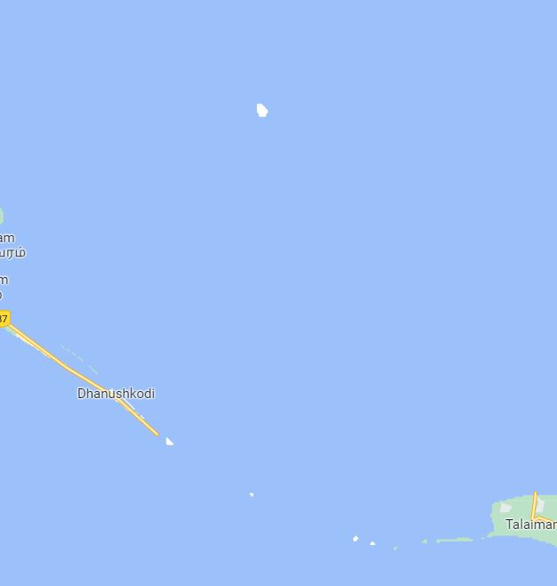
Applications
In search and rescue operations of maritime. We have several navigation methods to do with sarts .But when it come to certain things passive transponders have more gain over active transponders.
We can use it track the fisher man ships and it is less in cost which around It can track up to 500 meters and no need battery to maintain it.
Indo Pak Border
Sri Lanka border

Slide 43
We have recent news where Indian fishermen from Gujarat had accidentally entered to Pakistan maritime route for fishing instead we can use this transponders and can detect our civilian ships and enemy civilian ships and we can protect them from not entering the enemy seashore.
Same like this case with Sri Lanka and Indian marine borders in near Kachchatheevu Island .
So radars are introduced near the borders and so that they can track our transponders which are attached with fishermen boat and using passive over active best because mainly because of their cost which is have cost of around 1000-2000 rupees whereas active transponders have a cost of around 10000-20000 rupees with extra battery maintance.

Slide 44
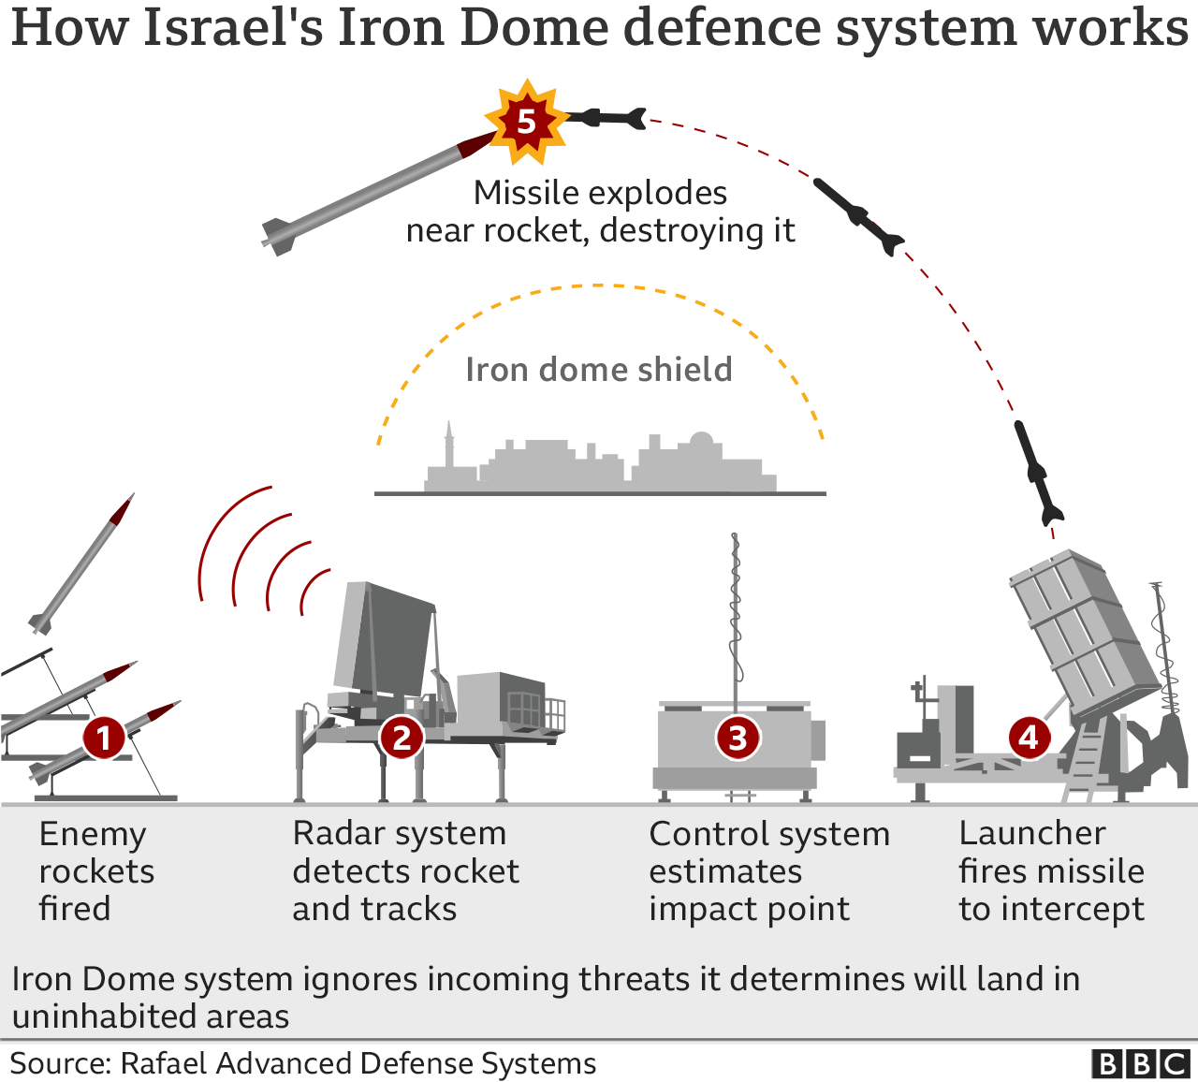
In Iron dome technology developed by Israel we can use this kind of transponders to track the intercepting missiles .So this way we can use it in various applications of search and rescue or search and track or tracking etc:-
Thief's pants are integrated with sart ’s so that they can't escape from jail and It also can be used to track employees in the government offices etc:-

Slide 45
References
Passive Short Range X-band Frequency Doubling Transponder,National University of Singapore.
Houda Werfelli, KTayari, M Chaoui, M Lahiani and H Ghariani, “Design of Rectangular Microstrip Patch Antenna”, In the Proceedings of Second International Conference on Advanced Technologies for Signal and Image Processing, Moastir, Tunisia, March 21-23, 2016
https://www.hindawi.com/journals/ijap/2017/2018527/ (for DFGS)
K. F. Lee and K. M. Luk, Microstrip Patch Antennas. London, U.K.:
Imperial College Press, 2011.

Slide 46
Thank you

